Slide 1
A binary relation from A to B is a set R of ordered pairs where the first element from each ordered pair comes from A and the second one from B.
Notation: a R b denotes that (a,b) Є R
Example:
Let A = {a,b}
B = {1,2}
Then
R={(a,1),(a,2),(b,1)} is a relation from A to B.
(b,2) is in A X B
Note that (b,1) belongs to R but not (b,2)

Slide 2
Function as Relations
Relations are generalization of functions that can be used to represent much wider class of relationships between sets.
Functions can be visualized as subset of relations.
Example: F: A ⊂ B is a subset of A x B

Slide 3
Relations on a Set
A relation on a set A is represented as A to A
Example: A = {1,2,3}, R = {(a, b)| a < b}
Represented as {(1,2), (2,3),(1,3)}

Slide 4
Properties of Relations
A relation R on a set A is reflexive if
(a, a) Є R for element a Є A
Example: A = {1,2,3}
R₁ ={(1,1),(1,2),(2,1),(2,2)}
R₂ ={(1,1), (1,2), (1,3), (2,1), (2,2), (3,3)}
Here, R₂ is reflexive whereas R₁ is not.
R₁ contains (1,1) & (2,2) but not (3,3).

Slide 5
Properties of Relations…(continued)
A relation R on a set A is symmetric if (b,a) Є R
whenever (a,b) Є R, for all a, b Є A
A relation R on a set A such that (a,b) Є R and
(b,a) Є R only if a = b, for all a,b Є A, is called
antisymmtric.

Slide 6
Properties of Relations…(continued)
Example: A = {1,2,3}
R₁ ={(1,1),(1,2),(2,1)}
R₂ ={(1,1), (1,2), (1,3), (2,2), (3,3)}
Here, R₁is symmetric because in each case (b,a)
belongs to the relation whenever (a,b) does.
R₂ is antisymmetric. There is no pair of elements
a and b with a≠b such that both (a,b) and (b,a)
belongs to the relation.

Slide 7
Properties of Relations…(continued)
A relation R on a set A is transitive if (a,b) Є R
and (b,c) Є R, then (a,c) Є R, for all a,b,c Є A.
Example: A = {1,2,3}
R₁ ={(1,1),(1,2),(2,1),(2,2)}
R₁ is transitive.

Slide 8
Combining Relations
R₁ ={(1,1),(2,2),(3,3)}
R₂ ={(1,1), (1,2), (1,3), (1,4)}
R1 U R2 ={(1,1),(2,2),(3,3), (1,2), (1,3), (1,4)}
R1 – R2 = {(2,2),(3,3)}
R2 – R1 = {(1,2),(1,3),(1,4)}

Slide 9
Composite Relations
Let R be a relation from a set A to a set B and S a relation from set B to set C.
The composite of R and S is the relation consisting of ordered pairs (a,c), where a Є A, c Є C, and for which there exists an element b Є B such that (a,b) Є R and (b,c) Є S.
The composite of R and S is denoted by S º R.

Slide 10
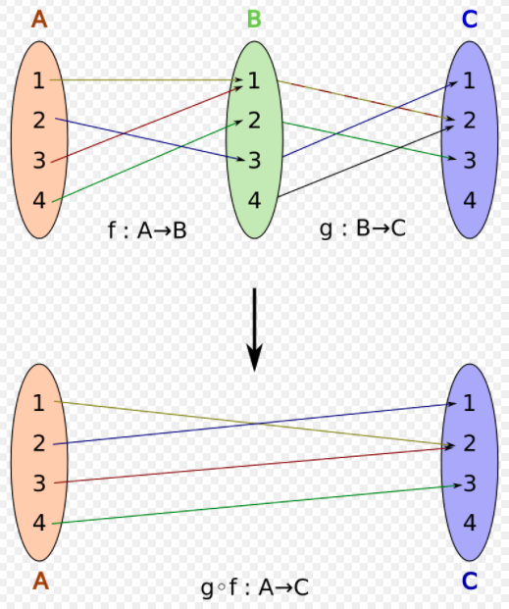

Slide 11
Composite Relations
Example: A = {1,2,3}
B = {1,2,3,4}
C = {0,1,2}
R:A⊂B
R = {(1,1), (1,4), (2,3), (3,1), (3,4)}
S:B⊂C
S = {(1,0), (2,0), (3,1), (3,2), (4,1)}
S º R = {(1,0),(1,1),(2,1),(2,2),(3,0),(3,1)}

Slide 12
Composite Relations
Let R be a relation on the set A.
The powers R^{n},n = 1,2,3,… are defined recursively by
R¹ = R and R^{n+1} = R^{n o} R
The relation R on a set A is transitive if and only if R^{n} R for n = 1,2,3,…

Slide 13
Representing Relation
Different ways of representing Relation are:
Ordered pairs (which we have already seen)
Zero-one matrices (useful for representing relations in computer programs)
Directed Graphs (useful in understanding the properties of relations)

Slide 14
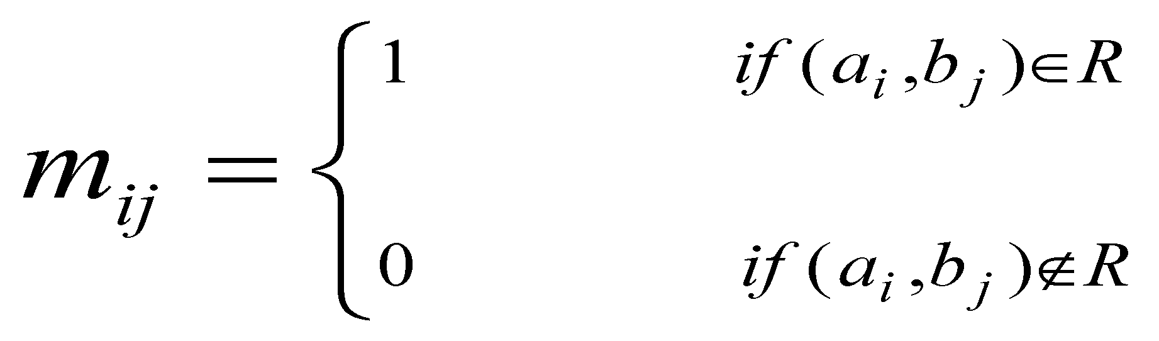
Representing Relation using Matrices
Let A = {a₁ ,a₂ ,a₃,…,a_{m} }
B = {b₁ ,b₂ ,b₃ ,…,b_{n} }
The relation R can be represented by the matrix
M_{R} = [m_{ij}], where

Slide 15
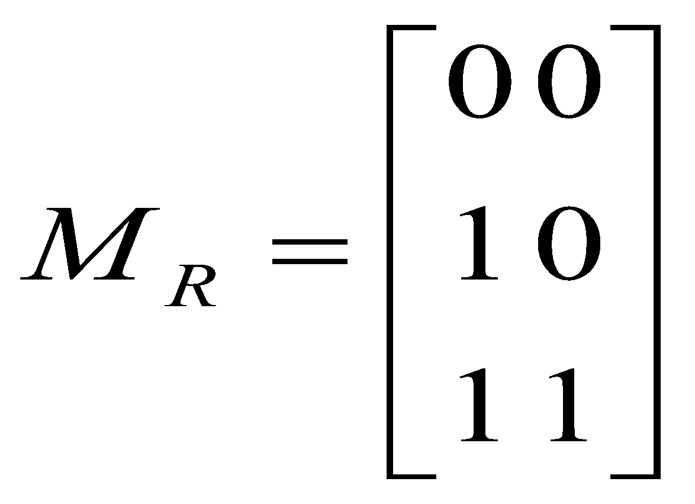
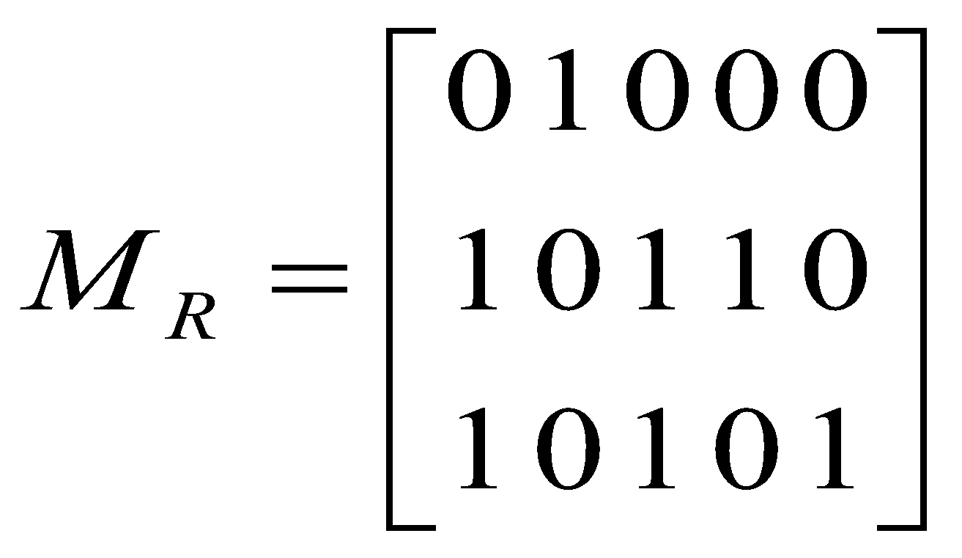
Representing Relation using Matrices
Example 1:
A = {1,2,3} B = {1,2}
Given R = {(2,1),(3,1),(3,2)}
Find M_{R}?
Example 2:
A = {1,2,3} B = {1,2,3,4,5} Given
Find R?
R = {(1,2), (2,1), (2,3), (2,4), (3,1), (3,3), (3,5)}

Slide 16
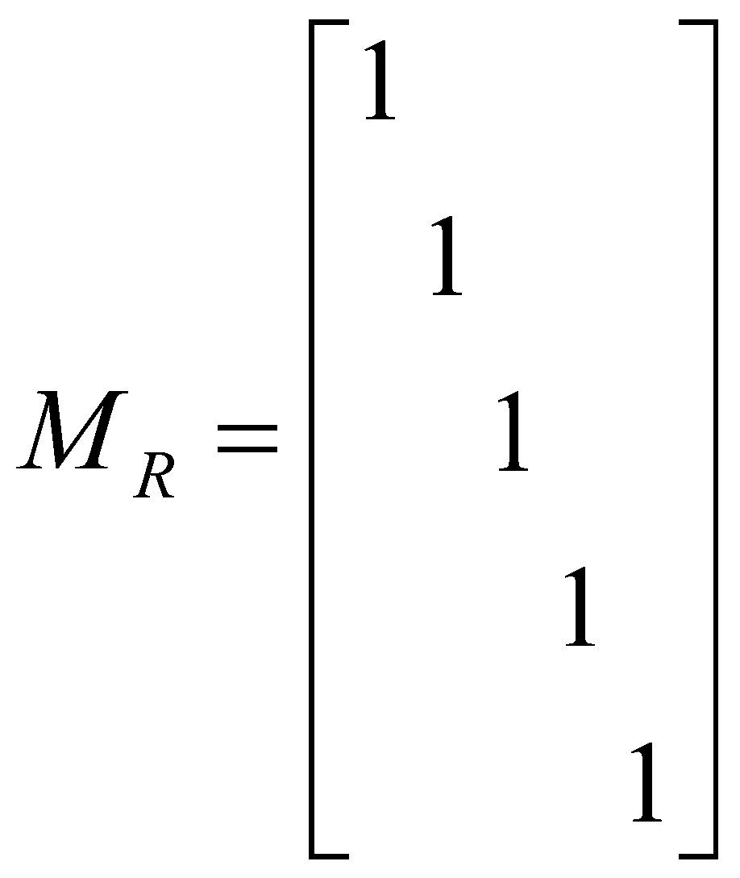
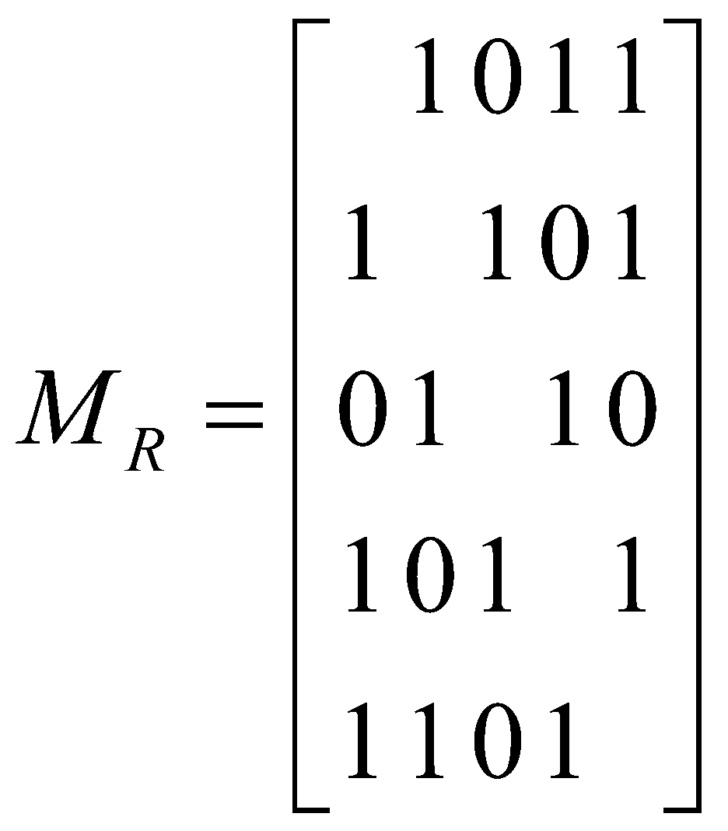
Relation Properties using Matrices
R is reflexive if and only if
m_{ii} = 1, for i = 1,2,…,n. i.e
if all the diagonal elements
of M_{R} are equal to 1.
R is symmetric if and only
if m_{ij} = m_{ji}, for all pairs of
integers i and j with
i = 1,2,…,n and
j = 1,2,…,n

Slide 17
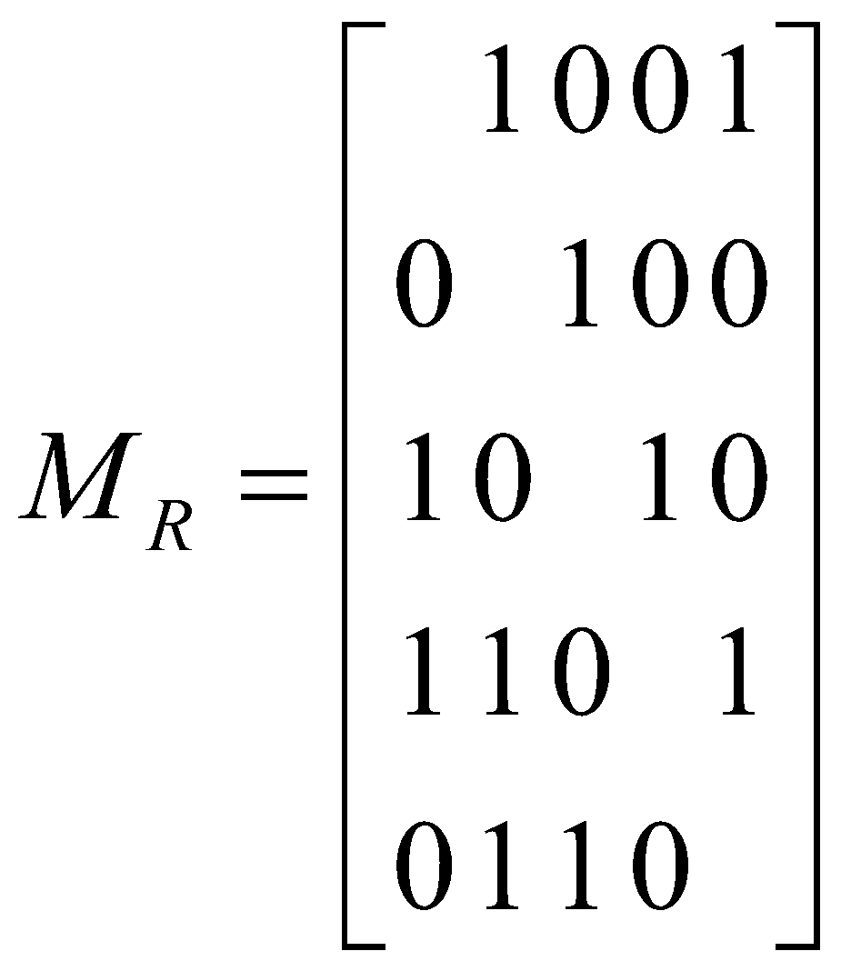
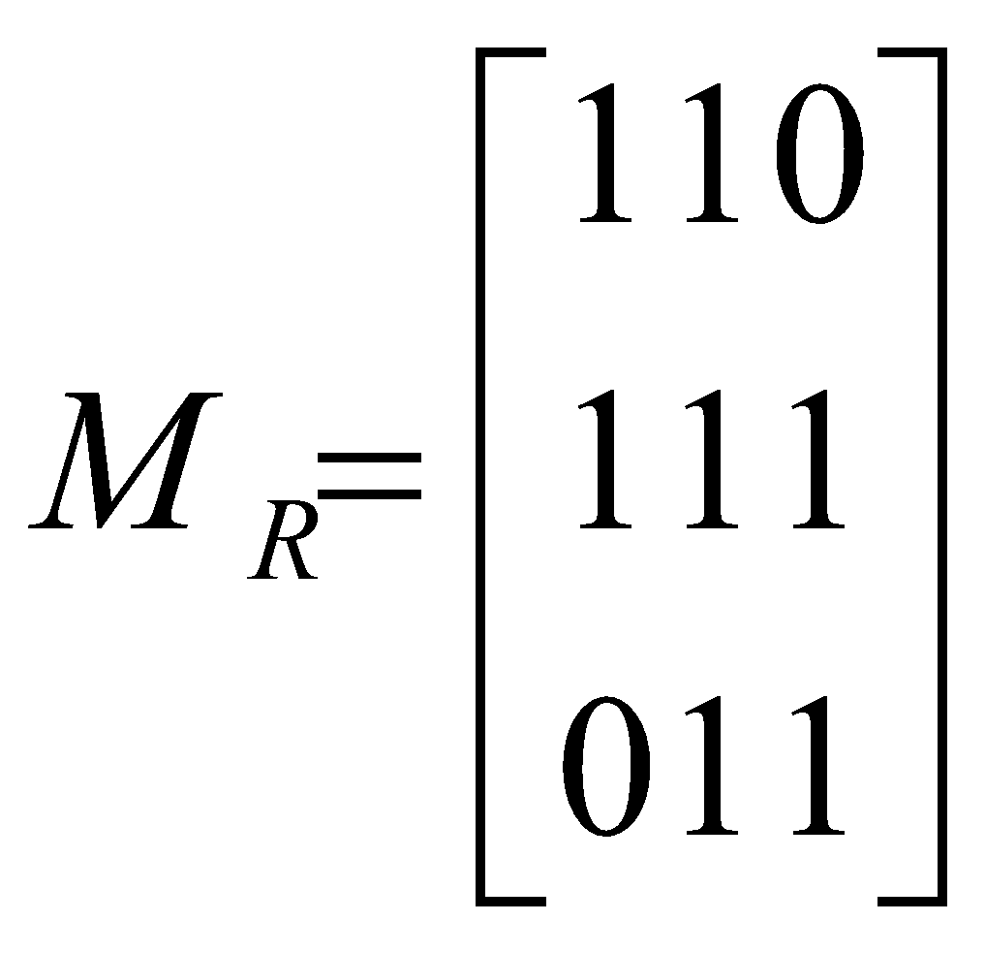
Relation Properties using Matrices
R is antisymmetric if and
only if m_{ij} = 1 with i ≠ j,
then m_{ji} = 0
Example: The relation R on a
set is given by
Is R reflexive, symmetric, and/or antisymmetric ?
R is reflexive, symmetric and not antisymmetric.

Slide 18
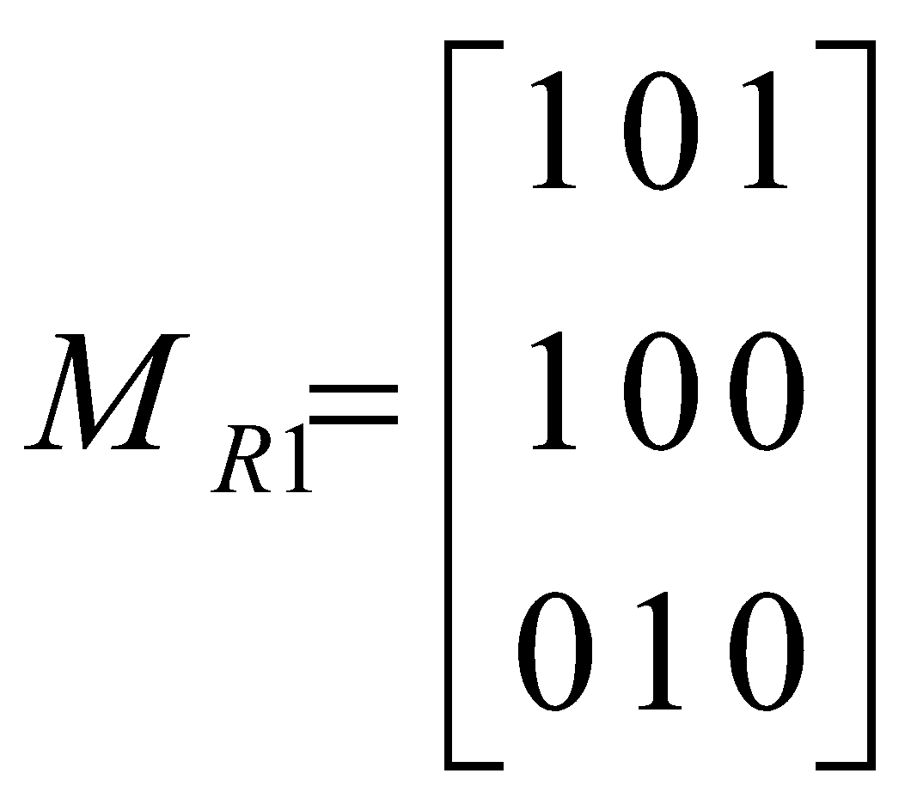
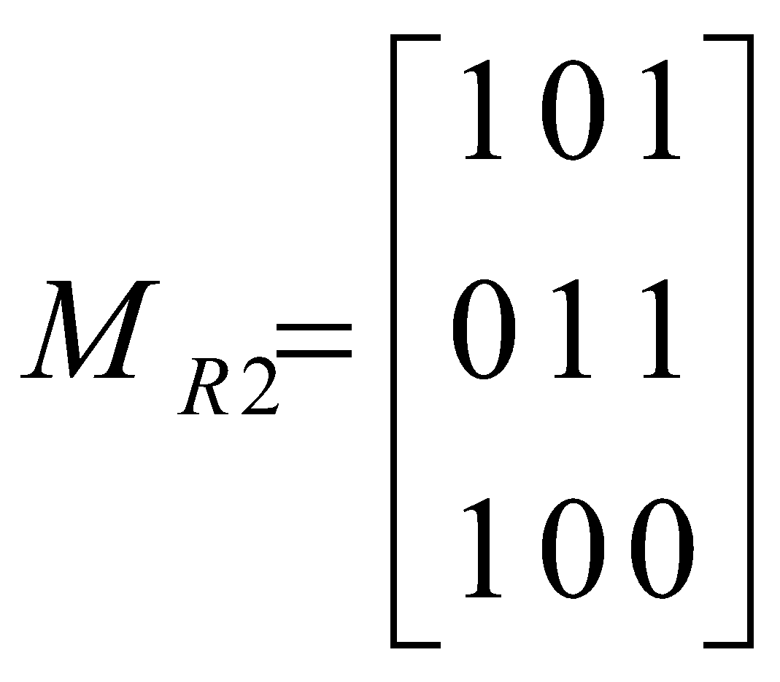


Relations & Matrices
M_{R1UR2} =
M_{R1} o M_{R2} =

Slide 19
Representing Relation using Digraphs
A directed graph, or digraph, consists of a set V of vertices together with a set E of ordered pairs of elements of V called edges. The vertex a is call the initial vertex of the edge (a,b), and the vertex b is called the terminal vertex of this edge.
Example:
R = {(A,B), (A,C), (A,D), (B,D),
(C,D), (C,E), (D,E), (E,A)}
E
D
C
B
A

Slide 20
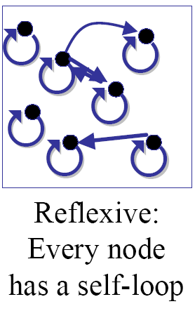
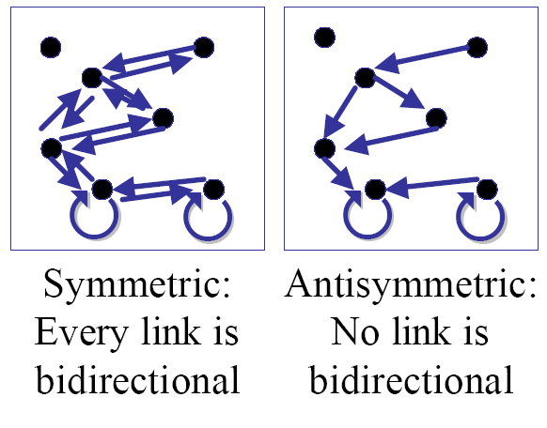
Relation Properties using Digraphs

Slide 21
Relation Properties using Digraphs
A relation R is transitive if and only if whenever there is an edge from vertex x to a vertex y and an edge from a vertex y to a vertex z, there is an edge from x to z

Slide 22
Closures of Relations
Let R be a relation on a set A. R may or may not have
some property P, such as reflexivity, symmetry, or
transitivity.
If there is a relation S with property P containing R such
that S is a subset of every relation with property P
containing R, then S is called the closure of R with
respect to P.
3 types of Closures exists:
1. Reflexive Closure
2. Symmetric Closure
3. Transitive Closure

Slide 23
Reflexive Closure
Given a relation R on a set A is not reflexive.
The reflexive closure of R can be formed by adding ordered
pairs (a,a) not already in A, where a Є A.
These new additions will make the new relation reflexive
which contains R.
Example: A = {1,2,3}
Let R = {(1,1), (1,2), (2,1), (3,2)}
S = {(1,1), (1,2), (2,1), (3,2), (2, 2), (3, 3)}
R is not reflexive since it does not contain (2,2) and (3,3).
Adding these two ordered pairs to R will make the new relation,
say S, reflexive. Also, S contains R.
Thus, S is a reflexive closure of R.

Slide 24
Symmetric Closure
Given a relation R on a set A is not symmetric.
The symmetric closure of a relation R can be constructed by adding all the ordered pairs of the form (b,a), where (a,b) is in R, that are not already in R.
Example: A = {1,2,3}
Let R = {(1,1), (1,2), (2,1), (3,2)}
S = {(1,1), (1,2), (2,1), (3,2), (2,3)}
The ordered pair (2,3) is to be added to R. This new relation S
will then be symmetric. S will then be called the symmetric
closure of R.

Slide 25
Transitive Closure using Digraphs
A Path from a to b in the directed graph in G is a sequence of
edges (x₀,x₁),(x₁,x₂),…,(x_{n-1},x_{n}) in G, where n is a nonnegative
integer, and x₀ = a and x_{n} = b, that is, a sequence of edges
where the terminal vertex of an edge is the initial vertex in
the next edge in the path. The path is denoted by x₀, x₁, x₂,…,
x_{n-1}, x_{n} and has length n.
Example: Consider the directed graph G:
Path(A,E) = {A,C,E},{A,D,E},{A,B,D,E},
{A,C,D,E}
E
D
C
B
A

Slide 26
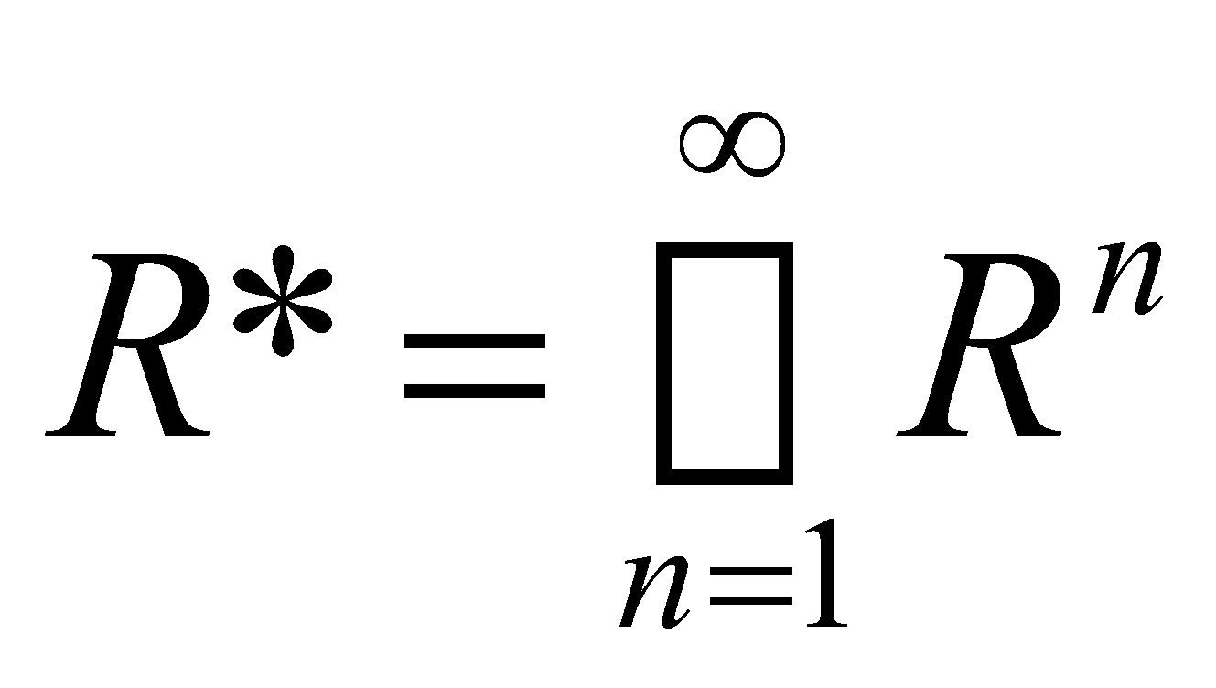
Transitive Closure using Digraphs
Let R be a relation on a set A.
There is a path of length n, where n is a positive integer, from a to b if and only if (a,b) Є R^{n}.
The connectivity relation R* consists of the pairs (a,b) such that there is a path of length at least one from a to b in R.
R^{n} consists of the pairs (a,b) such that there is a path of length n from a to b, it follows that
The transitive closure of a relation equals the connectivity relation R*

Slide 27
Transitive Closure using Digraphs
Given a digraph G, the transitive closure of G is the digraph G* such that
G* has the same vertices as G
if G has a directed path from u to v (u ≠ v), G* has a directed edge from u to v
The transitive closure provides reachability information about a digraph
D
E
B
G
C
A
D
E
B
C
A
G*

Slide 28
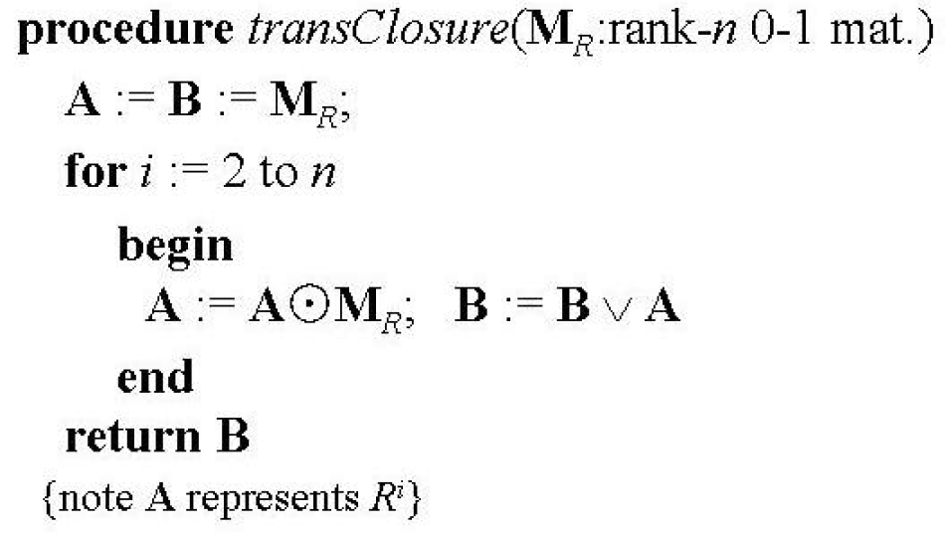
Transitive Closure using Matrices
Let M_{R} be the zero-one matrix of the relation R.
The zero-one matrix of the transitive closure R* is
M_{R*} = M_{R}∨M_{R}^{[2]}∨M_{R}^{[3]}∨…∨M_{R}^{[n]}
Procedure for computing the transitive closure

Slide 29
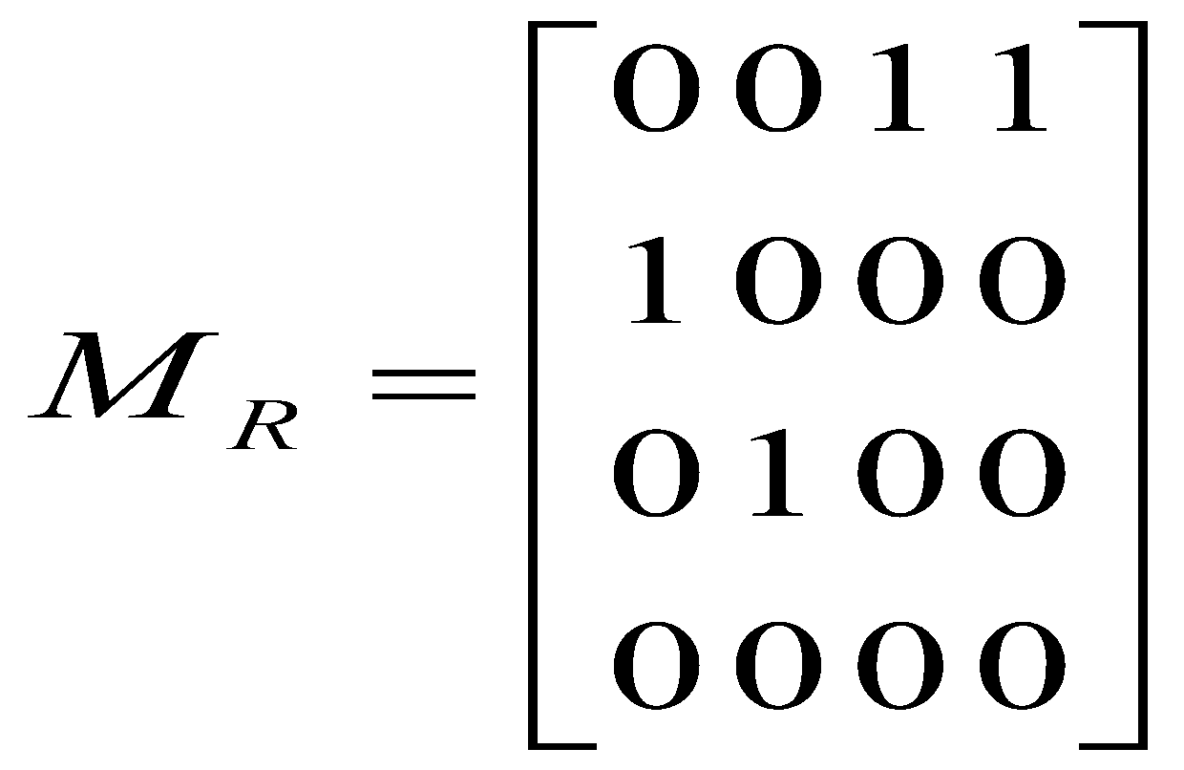
Transitive Closure using Matrices
Example: A = {1, 2, 3, 4}
R = {(1, 3), (1, 4), (2, 1), (3, 2)}
R can be represented by the following matrix M_{R}:

Slide 30
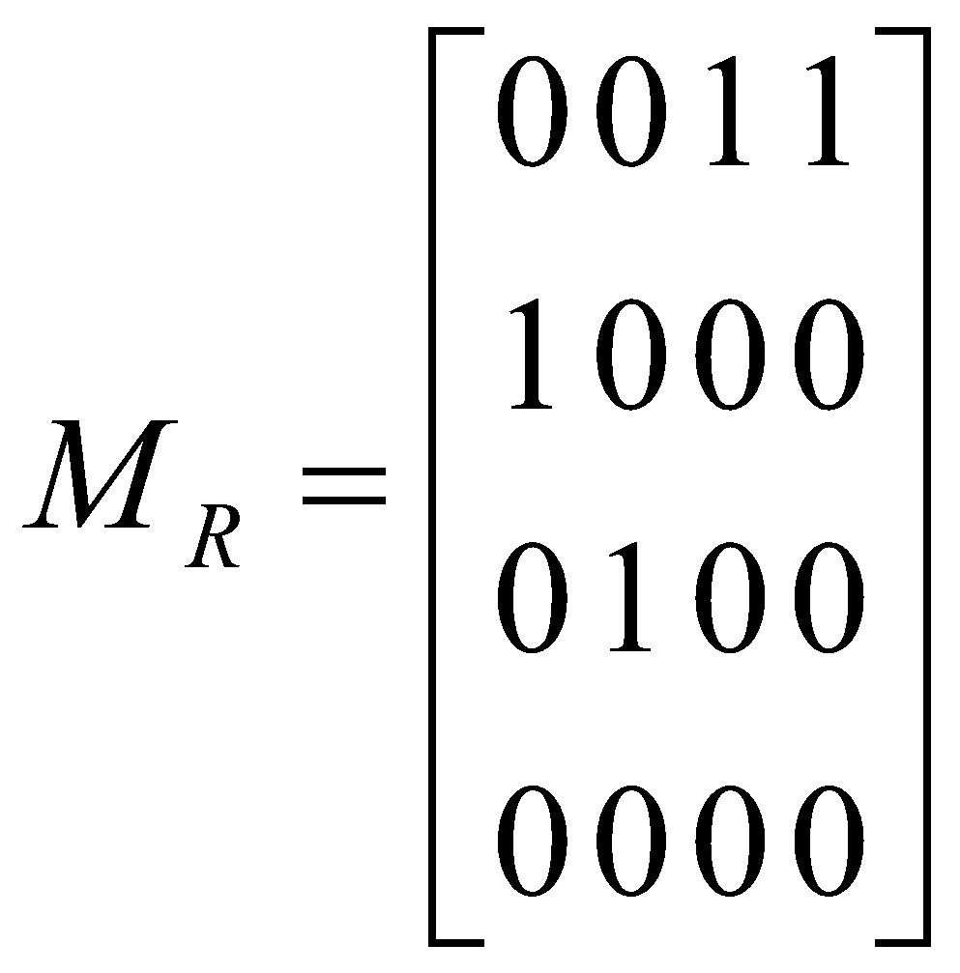
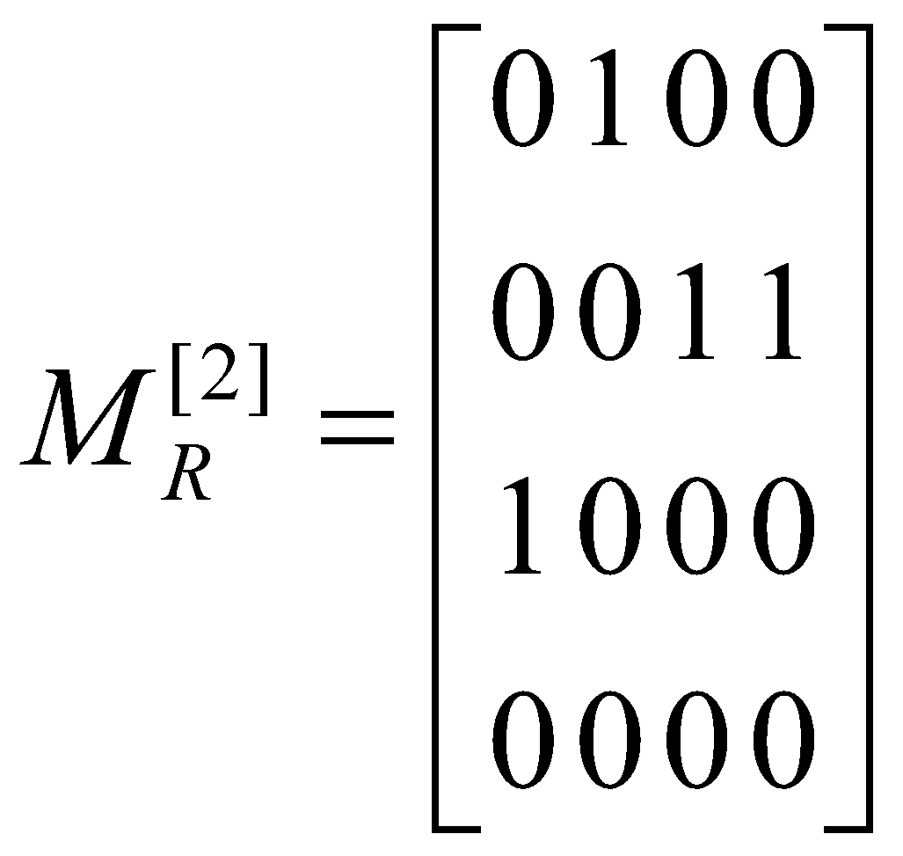
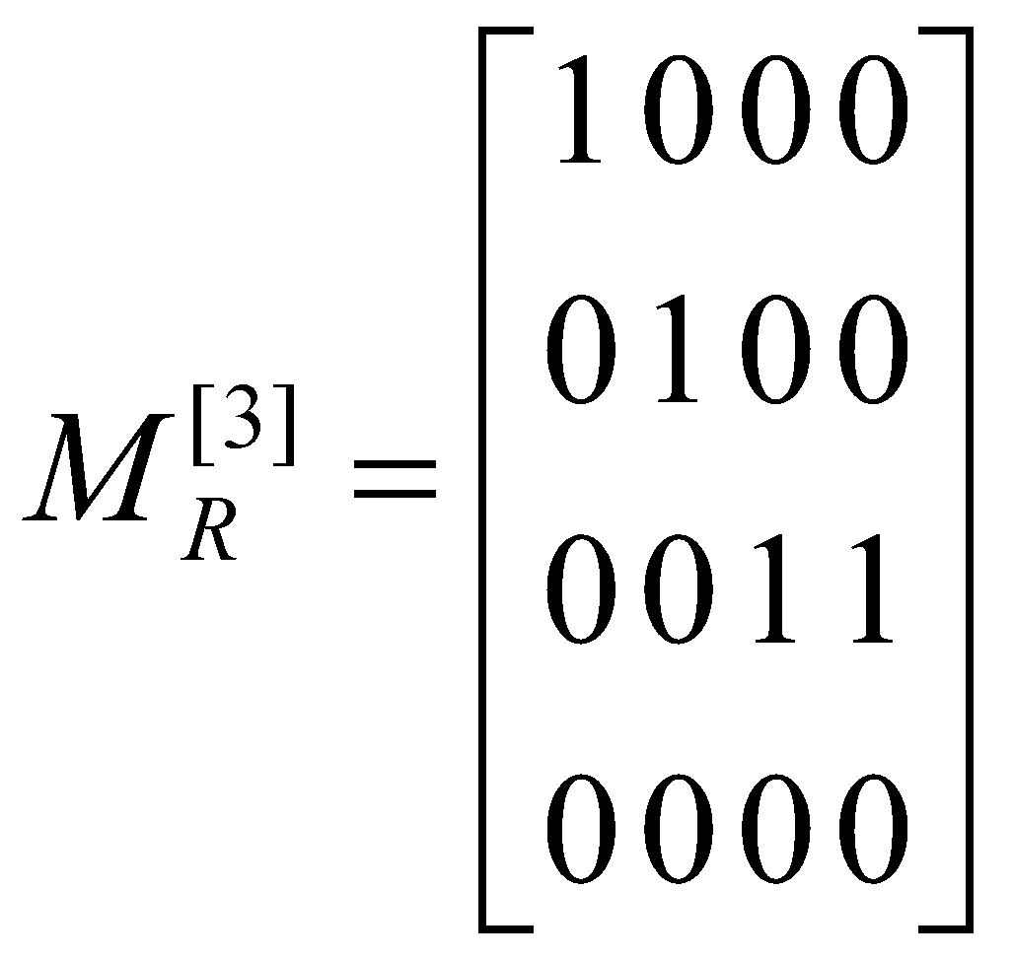
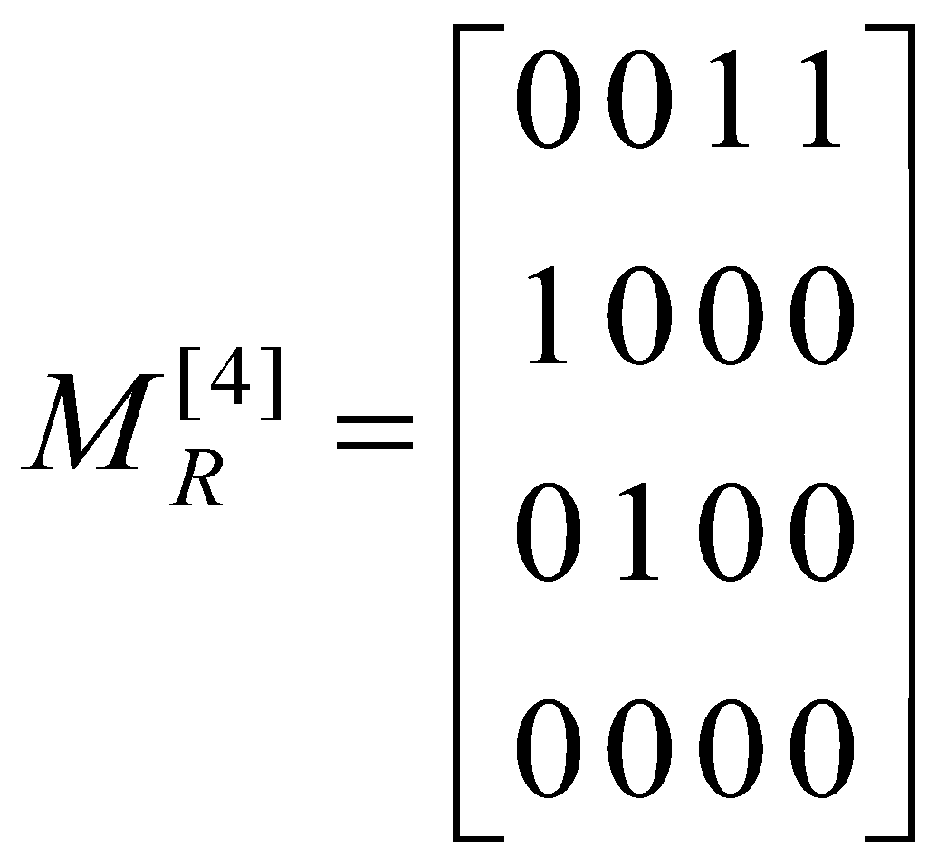
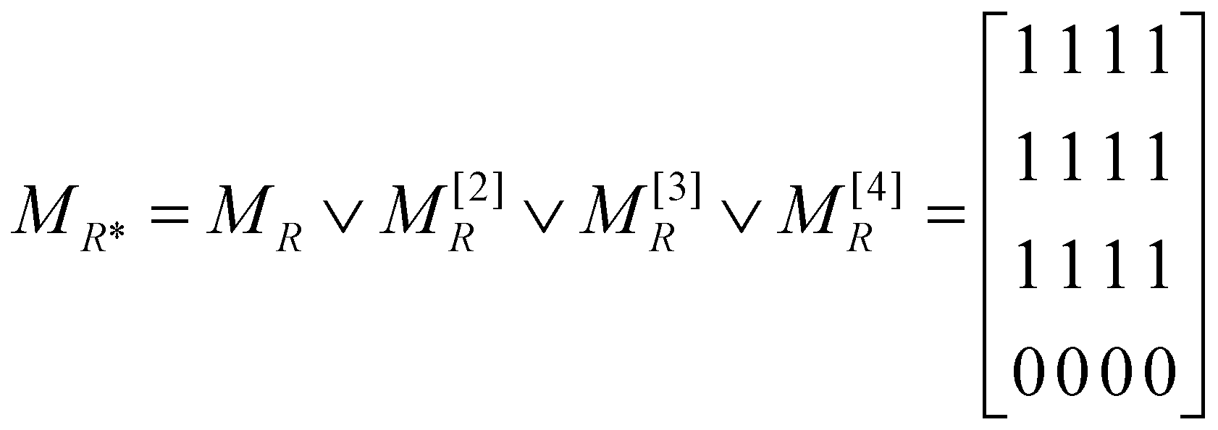
Transitive Closure using Matrices

Slide 31
Warshall’s Algorithm
Warshall’s Algorithm is based on the construction of a sequence of zero-one matrices.
If a, v₁,v₂,…,v_{k},b is a path, its interior vertices are v₁,v₂,…,v_{k}
The algorithm computes W_{k} = [w_{ij}^{(k)}], where w_{ij}^{(k)} = 1 if there exists a path from v_{i} to v_{j} such that all interior vertices of this path are in the set {v₁,v₂,…,v_{k}} and is 0 otherwise.

Slide 32
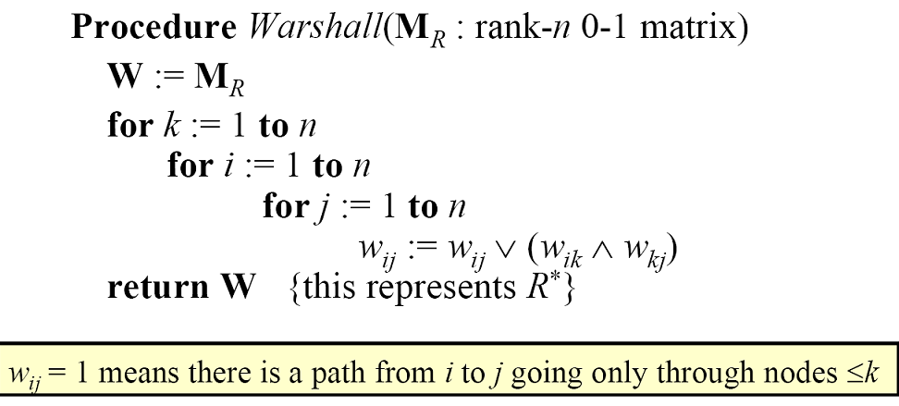
Warshall’s Algorithm

Slide 33
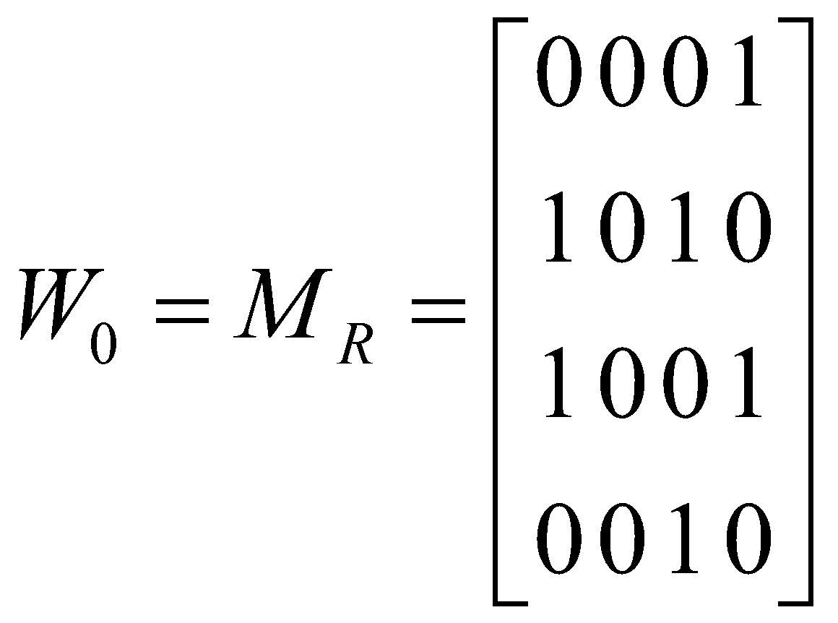
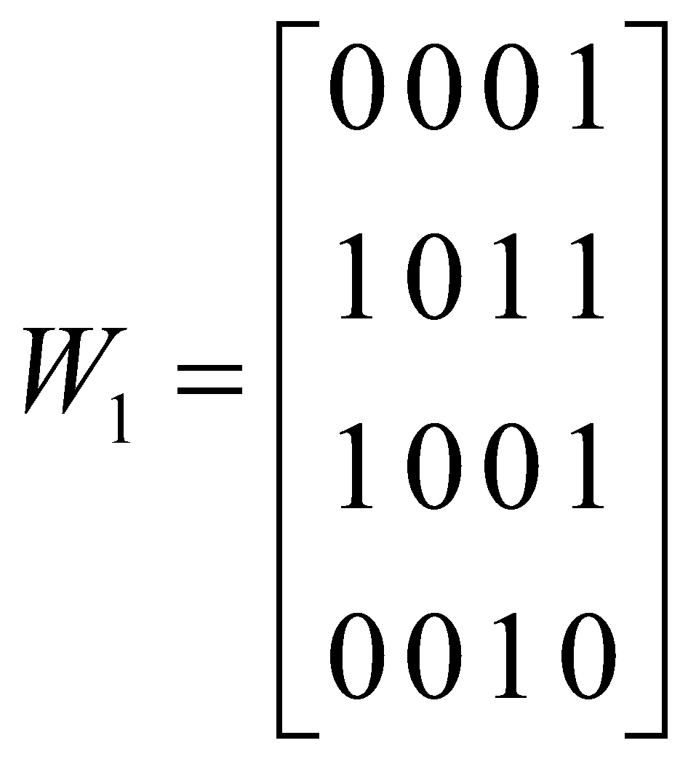
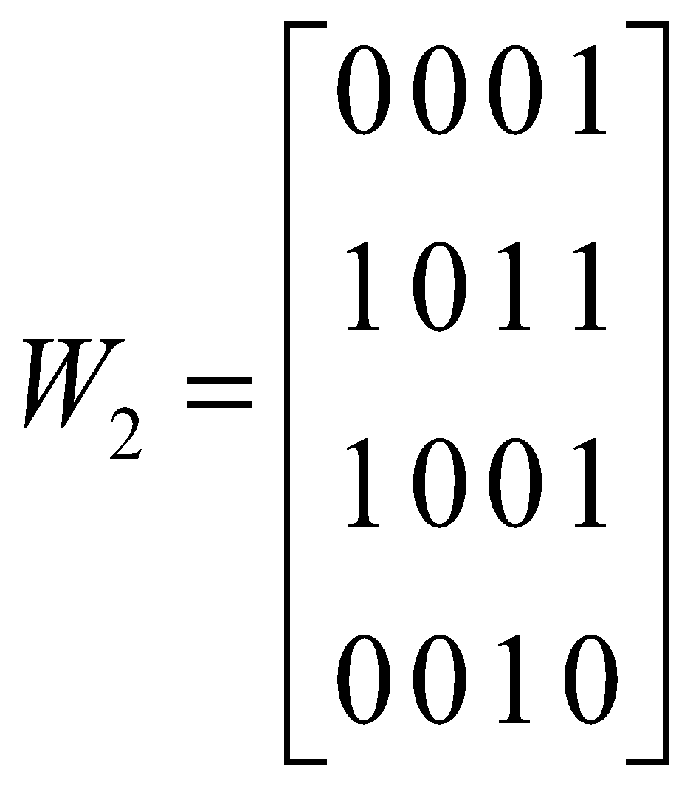
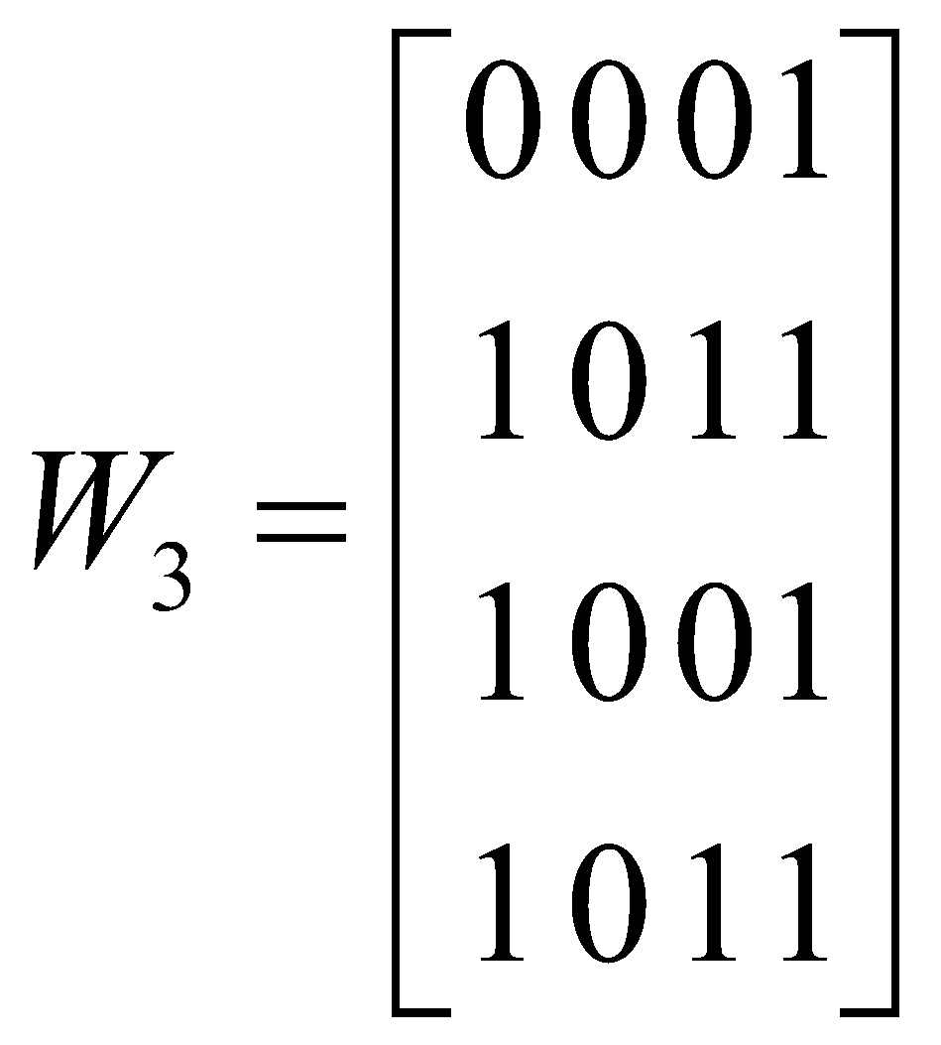
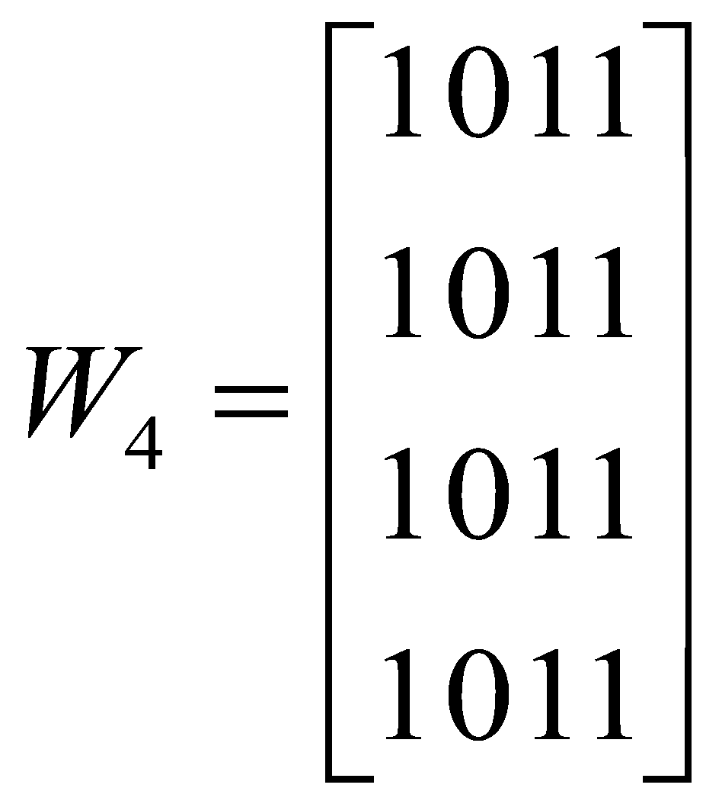
Warshall’s Algorithm
Example: A = {a,b,c,d}
R = {(a,d), (b,a), (b,c), (c,a), (c,d), (d,c)}
W₄ is the matrix of the transitive closure.

Slide 34
Equivalence Relations
A relation R on a set A is called an equivalence relation if and only if
1. R is reflexive
2. R is symmetric, and
3. R is transitive
Example:
The congruent modulo m relation on the set of integers i.e.
{<a, b>| a Ξ b (mod m)}, where m is a positive integer
greater than 1, is an equivalence relation.

Slide 35
Equivalence Classes
For an equivalence relation R on a set A, the set of the elements of A that are related to an element, say a, of A is called the equivalence class of element a.
The equivalence class of a is denoted by [a].
[a] = {s | (a, s) Є R}.
IF b Є [a], then b is called a representative of this equivalence class.

Slide 36
Equivalence Classes
Example:
For the equivalence relation of hours on a clock, equivalence classes are [1] = {1, 13, 25, ... } = {1+ 12n: n Є N} , [2] = {2, 14, 26, ... } = {2+ 12n: n Є N} , ........, where N is the set of natural numbers. There are altogether twelve of them.

Slide 37
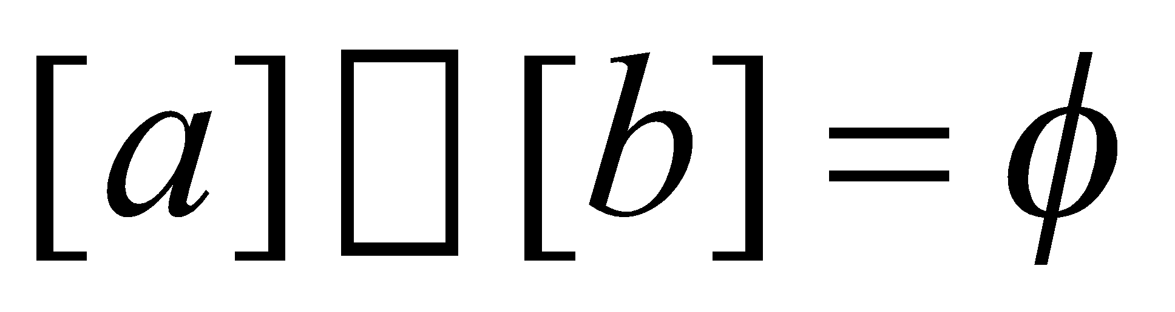
Equivalence Classes and Partitions
For an equivalence relation R on a set A, every element of A is in an equivalence class. For if an element, say b , does not belong to the equivalence class of any other element in A, then the set consisting of the element b itself is an equivalence class.
Another property of equivalence class is that equivalence classes of two elements of a set A are either disjoint or identical, that is either
1. [a]=[b]
2.
Thus the set A is partitioned into equivalence classes by an equivalence relation R on A.

Slide 38
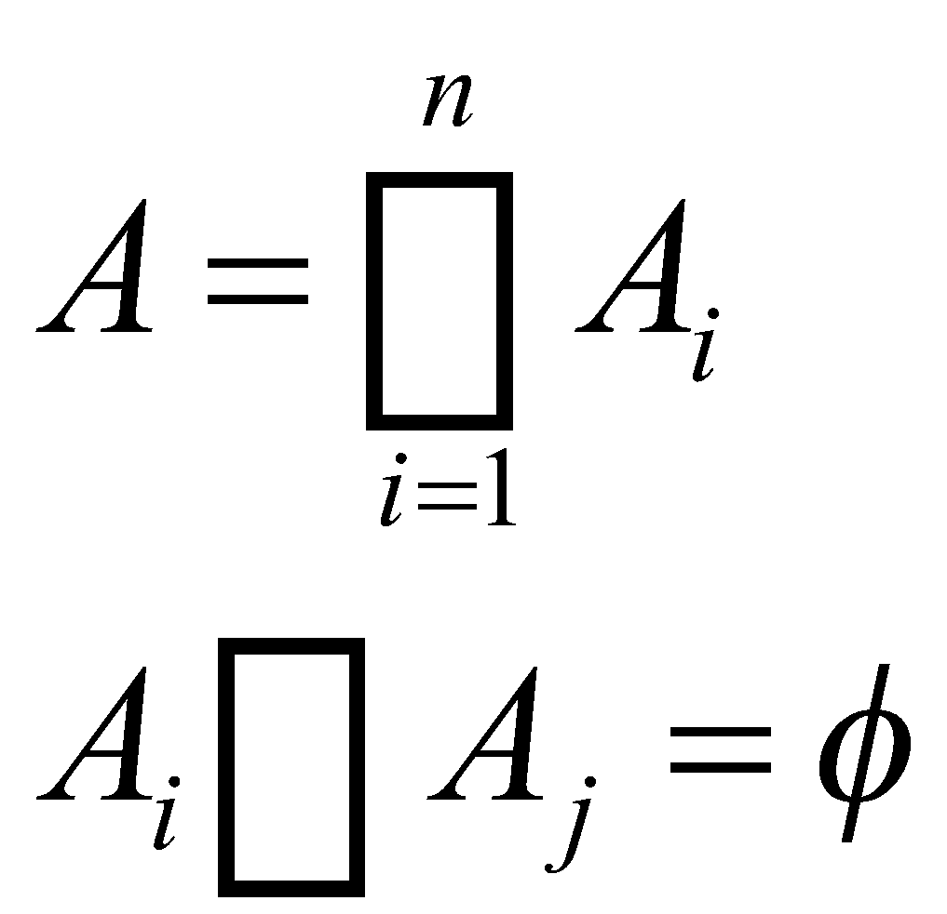
Equivalence Classes and Partitions
Let A be a set and let A₁, A₂, ..., A_{n} be subsets of A. Then {A₁, A₂, ..., A_{n} } is a partition of A, if and only if
1.
2. if A_{i} ≠A_{j} , 1≤ i, j ≤ n
Example:
A = {1, 2, 3, 4, 5}
A₁ = {1, 5}, A₂ = {3}, and A₃ = {2, 4}.
Then {A₁, A₂, A₃} is a partition of A since the subsets satisfy both the
conditions.
However, B₁ = {1, 2, 5}, B₂ = {2, 3}, and B₃ = {4} do not form a
partition for A.

Slide 39
Equivalence Relations
Let R be an equivalence relation on a set S. Then the equivalence classes of R form a partition of S.
Conversely, given a partition {A_{i} | i Є I} of the set S, there is an equivalence relation R that has the sets A_{i}, i Є I, as its equivalence classes.
Example: S = { 1,2,3,4,5,6}
A₁ = {1,2,3}, A₂ = {4,5}, and A₃ = {6}
{A₁, A₂, A₃} are the equivalence classes of R. The pair (a, b) Є R
if and only if a and b are in the same equivalence class.
(1,1), (1,2), (1,3), (2,1), (2,2), (2,3), (3,1), (3,2), (3,3)
belong to R due to A₁.
Similarly, (4,4), (4,5), (5,4), (5,5) due to A₂ and (6,6) due to A₃

Slide 40
Partial Orderings
A relation R on a set S is called a partial ordering or partial order if and only if
1. R is reflexive
2. R is antisymmetric
3. R is transitive.
A set S together with partial ordering R is called a partially ordered set, or poset, and is denoted by (S,R).

Slide 41
Partial Orderings
Example:
The “greater than or equal” relation (≥) is a partial order on the set of integers
It is reflexive: a ≥ a for all a ∈ Z
It is antisymmetric: if a ≥ b then the only way that b ≥ a is when b = a
It is transitive: if a ≥ b and b ≥ c, then a ≥ c
Note that ≥ is the partial ordering on the set of integers
(Z, ≥) is the partially ordered set, or poset

Slide 42
Partial Orderings … (continued)
The symbol , is used to represent any relation when discussing partial orders
Not just the less than or equals to relation
Can represent ≤, ≥, ⊆, etc
Thus, a ⊑ b denotes that (a, b) ∈ R
The poset is (S,⊑)
The symbol  is used to denote a ➢ b but a ≠ b
If ➢ represents ≥, then  represents >

Slide 43
Comparability
The elements a and b of a poset (S, ) )are called comparable if either a ➢ b or b ➢ a.
Meaning if (a, b) ∈ R or (b, a) ∈ R
It can’t be both because ➢ is antisymmetric
🡪 Unless a = b, of course
If neither a ➢ b nor b ➢ a, then a and b are incomparable
🡪 Meaning they are not related to each other
If all elements in S are comparable, the relation is a total ordering.

Slide 44
Comparability
Example:
Let ➢ be the “divides” operator |
In the poset (Z⁺,|), are the integers 3 and 9 comparable?
Yes, as 3 | 9
Are 7 and 5 comparable?
No, as 7 | 5 and 5 | 7
Thus, as there are pairs of elements in Z⁺ that are not comparable, the poset (Z⁺,|) is a partial order.

Slide 45
Well-ordered sets
(S, R) is a well-ordered set if:
(S,➢) is a totally ordered poset
Every non-empty subset of S has a least element
Example: (Z,≤)
is a total ordered poset (every element is comparable to every other element)
It has no least element
Thus, it is not a well-ordered set
Example: (S,≤) where S = { 1, 2, 3, 4, 5 }
is a total ordered poset (every element is comparable to every other element)
Has a least element (1)
Thus, it is a well-ordered set

Slide 46
Lexicographic ordering
Consider two posets: (S,➢₁) and (T,➢₂)
Order Cartesian products of these two posets via
lexicographic ordering
Let s₁ ∈ S and s₂ ∈ S
Let t₁ ∈ T and t₂ ∈ T
(s₁,t₁)  (s₂,t₂) if either:
s₁ ₁ s₂
s₁ = s₂ and t₁ ₂ t₂
Lexicographic ordering is used to order dictionaries

Slide 47
Lexicographic ordering
Let S be the set of word strings (i.e. no spaces)
Let T be the set of strings with spaces
Both the relations are alphabetic sorting
Thus, posets are: (S,➢) and (T,➢)
Order (“run”, “noun: to…”) and (“set”, “verb: to…”)
As “run” ➢ “set”, the “run” Cartesian product comes before the “set” one
Order (“run”, “noun: to…”) and (“run”, “verb: to…”)
Both the first part of the Cartesian products are equal
“noun” is first (alphabetically) than “verb”, so it is ordered first

Slide 48
Lexicographic ordering
Consider the two strings a₁a₂a₃…a_{m}, and b₁b₂b₃…b_{n}
The formal definition for lexicographic ordering of strings is as
follows:
If m = n (i.e. the strings are equal in length)
(a₁, a₂, a₃, …, a_{m})  (b₁, b₂, b₃, …, b_{n}) using the
comparisons discussed
Example: “run”  “set”
If m ≠ n, then let t be the minimum of m and n then a₁a₂a₃…a_{m},
is less than b₁b₂b₃…b_{n} if and only if either of the following are true:
(a₁, a₂, a₃, …, a_{t})  (b₁, b₂, b₃, …, b_{t})
Example: “run”  “sets” (t = 3)
(a₁, a₂, a₃, …, a_{t}) = (b₁, b₂, b₃, …, b_{t}) and m < n
Example: “run”  “running”

Slide 49
Hasse Diagrams
Consider the directed graph for a finite poset ({1,2,3,4},≤).
Many edges in the directed graph for a finite poset do not have to be shown since they must be present.
4
3
2
1
4
3
2
1
4
3
2
1
4
3
2
1
_{Hasse}
_{Diagram}

Slide 50
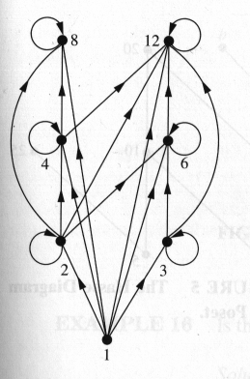
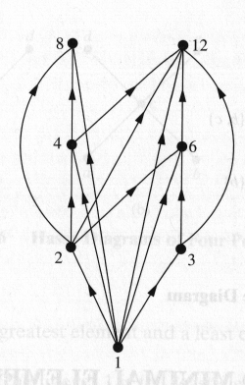
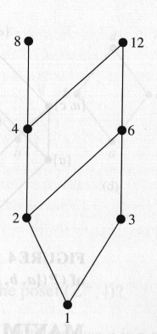
Hasse Diagrams
Example: For a poset ({1,2,3,4,5,6},|)

Slide 51
Maximal and Minimal Elements
Let (A, R) be a poset.
An element of a poset is called maximal if it is not less than any element of the poset.
🡪 a is maximal in the poset (A, R) if there is no b Є A
such that a R b
An element of a poset is called minimal if it is not greater than any element of the poset.
🡪 a is minimal in the poset (A, R) if there is no b Є A
such that b R a

Slide 52
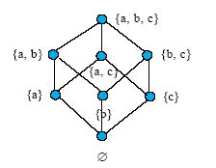
Maximal and Minimal Elements
Example: Consider the Hasse Diagrams of P({a,b,c}, ⊆ )
{a,b,c} is the maximal element and Φ is the minimal element

Slide 53
Maximal and Minimal Elements
Consider the following poset ({2,4,5,10,12,20,25},|)
₁₂
₂₀
_{Maximal Elements : 12, 20, 25}
_{Minimal Elements : 2, 5}
₄
₁₀
₂₅
₂
₅

Slide 54
Least and Greatest Element
Let (A,R} be a poset.
A element a in A is the least element in A if every element b in A, a R b.
A element a in A is the greatest element in A if every element b in A, b R a.
_{c}
_{d}
_{d}
_{d}
_{e}
_{(i) Least Element : a}
_{Greatest Element : No Element}
(ii) Least Element : No Element
_{Greatest Element : d}
(iii) Least Element : No Element
_{Greatest Element : No Element}
_{b}
_{c}
_{c}
_{a}
_{b}
_{a}
_{a}
_{b}
_{(i)}
_{(ii)}
_{(iii)}

Slide 55
Upper and Lower Bound
Let S be the subset in the poset (A,R).
If there exists a element a in A such that s R a for all s in S, then a is called an upper bound.
If there exists a element a in A such that a R s for all s in S, then a is called an lower bound.

Slide 56
Upper and Lower Bound
Example: Consider the following poset with the Hasse Diagram
Subsets:
{a,b,c}: Upper Bound: e,f,j,h
Lower Bound: a
{j,h}: Upper Bound: No one
Lower Bound: a,b,c,d,e,f
{a,c,d,f}: Upper Bound: f,g,j
Lower Bound: a
_{h}
_{j}
_{g}
_{f}
_{d}
_{e}
_{b}
_{c}
_{a}

Slide 57
Least Upper and Greatest Lower Bound
Consider a poset (A,R).
The element x is called the least upper bound of the subset A if x is an upper bound that is less than every other upper bound of A.
The element y is called the greatest lower bound of A if y is an lower bound of A and z R y where z is a lower bound.

Slide 58
Least Upper and Greatest Lower Bound
Example: Consider the following poset with the Hasse Diagram
_{h}
_{j}
_{Least Upper Bound : {b,d,g}}
_{Upper Bound : g ,h}
_{Since g ➢ h, g is the least}
_{upper bound.}
_{Greatest Lower Bound : {b,d,g}}
_{Lower Bound : a, b}
_{Since a ➢ b, b is the greatest}
_{lower bound.}
_{g}
_{f}
_{d}
_{e}
_{b}
_{c}
_{a}

Slide 59
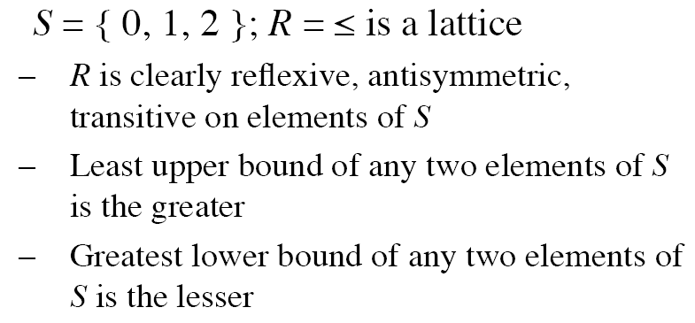

Lattices
A partially ordered set in which every pair of elements has both a least upper bound and greatest lower bound is called a lattice.
Example:

Slide 60
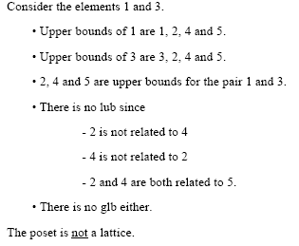
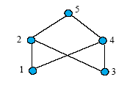
Lattices
Example:

Slide 61
Topological Sorting
A total ordering ➢ is said to be compatible with the partial ordering R if a ➢ b whenever a R b.
Constructing a compatible total ordering from a partial ordering is called topological sorting.
Topological sorting has application to the scheduling of projects.

Slide 62
Topological Sorting
Algorithm Topological Sort Input: A finite poset <A, R>.
Output: A sequence of the elements of A preserving the order R. i := 1;
while ( A ≠ Φ ) { pick a minimal element b_{i} from A; A := A - {b_{i}}; i := i + 1; output b }

Slide 63
Topological Sorting
Example: Consider a poset ({1,2,4,5,12,20},|)
₁₂
₂₀
The algorithm selects the minimal elements in the following order:
_{1🡪 5 🡪 2 🡪 4 🡪 20 🡪 12.}
The second minimal element can be either be 5 or 2.
Similarly, either 20 or 12 can be chosen at the later stage.
₄
₂
₅
₁

